Slide 1
Transmission Control Protocol/Internet Protocol (TCP/IP)
Leader: John Paul Manzano Member: Clarence Steven
Angelica Domasian
James Cabida

Slide 2
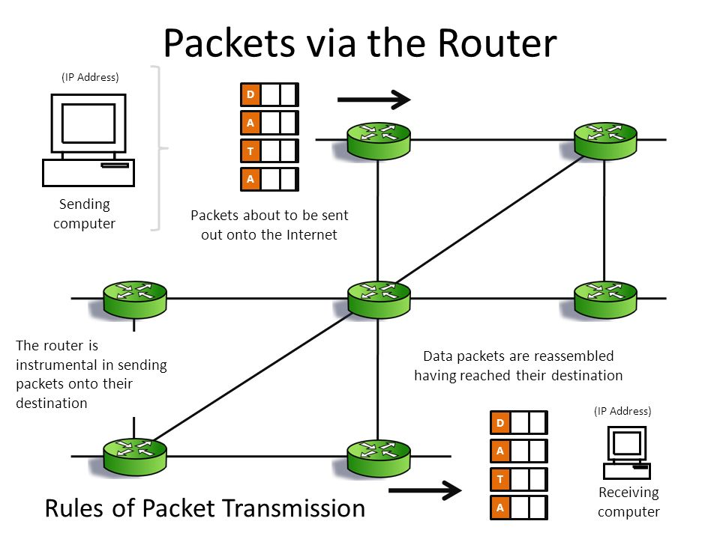
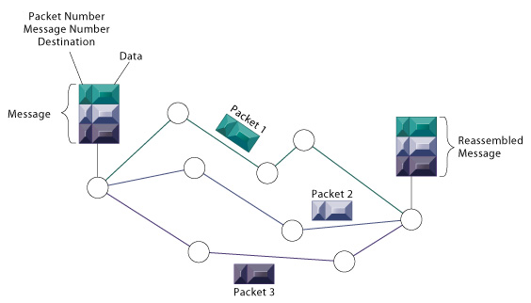
TCP/IP connections
Transmission Control Protocol/Internet Protocol (TCP/IP) connections are the foundation of the Internet and most other computer networks. TCP/IP is a suite of protocols that define how data is exchanged over the internet. It breaks down data into packets, addresses them, transmits them, routes them, and receives them at the destination.

Slide 3
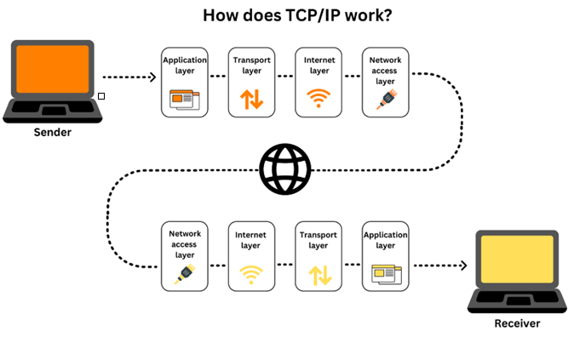
TCP/IP connections
IP obtains the address where data is sent (your computer has an IP address). TCP ensures accurate data delivery once that IP address has been found. Together, the two form the TCP/IP protocol suite. In other words, IP sorts the mail, and TCP sends and receives the mail.

Slide 4
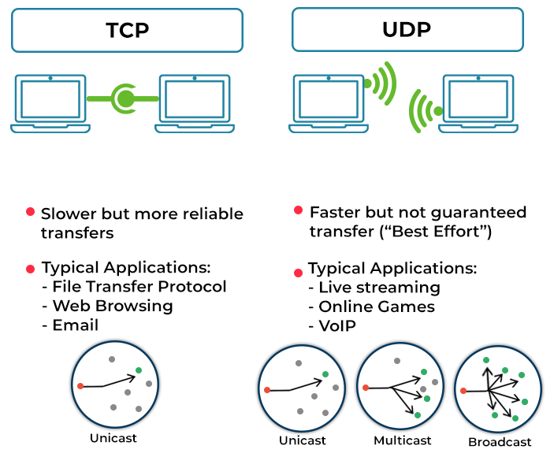
TCP/IP connections
TCP/IP connections can be either reliable or unreliable.
Reliable connections use TCP to ensure that data is delivered reliably and in the correct order. TCP does this by using sequence numbers and acknowledgments.
Unreliable connections use UDP (User Datagram Protocol) to send data without any guarantees of delivery or order. UDP is often used for applications where speed is more important than reliability, such as streaming video and audio.

Slide 5
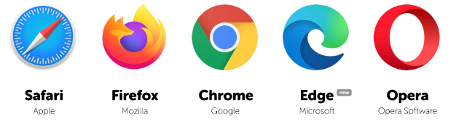









TCP/IP connections are used for a wide variety of applications, including:
Browsing the web
Sending and receiving email
Transferring files
Streaming video and audio
Playing online games
Making voice and video calls
Chatting

Slide 6
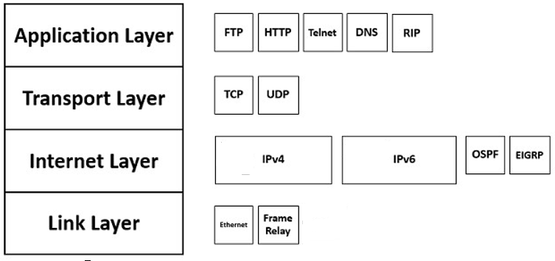
TCP/IP model
The TCP/IP model, also known as the Internet protocol suite, is a conceptual model that describes how data is communicated over a network. It is a suite of communication protocols used to interconnect network devices on the internet. TCP/IP is also used as a communications protocol in a private computer network (an intranet or extranet).

Slide 7
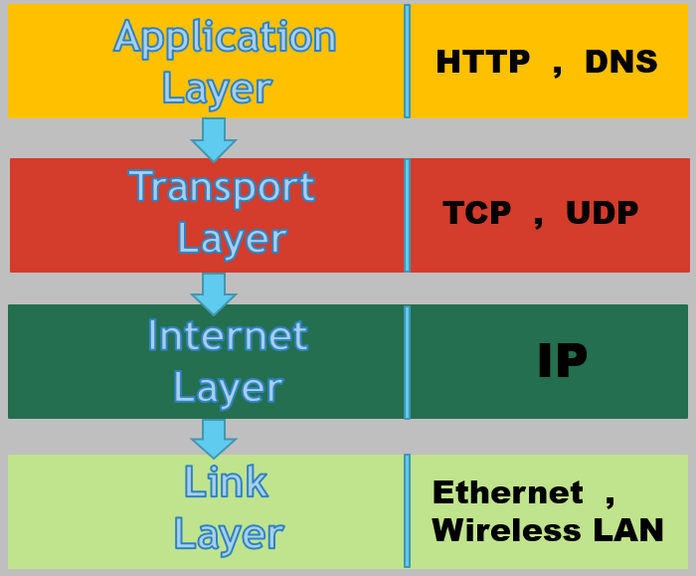
The Layers of the TCP/IP model:
Application layer: The application layer is responsible for providing services to applications, such as file transfer, email, and web browsing.
Transport layer: The transport layer is responsible for providing reliable end-to-end communication between applications. The two main transport protocols are TCP and UDP.
Internet layer: The Internet layer is responsible for routing packets of data across the network. The main protocol used at the internet layer is IP.
Link layer: The link layer is responsible for transmitting packets of data over a physical network medium, such as Ethernet or Wi-Fi.

Slide 8
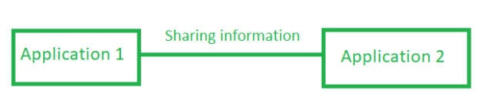






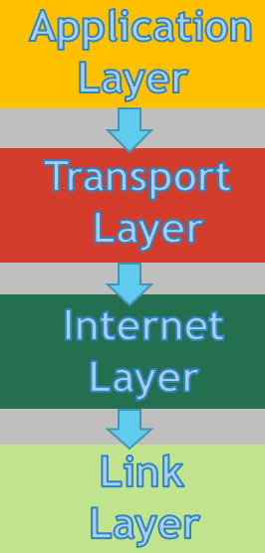
Application layer
The Application layer provides a way for applications to communicate with each other over a network.
It provides a variety of services to applications, such as file transfer, email, and web browsing.
The Application layer is also responsible for providing security services, such as encryption and authentication.
It is the highest layer in the TCP/IP model and is closest to the user.

Slide 9


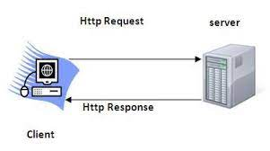

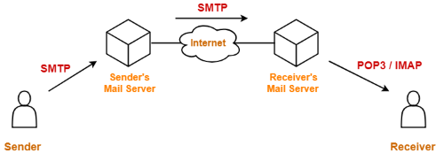
Application layer
Application layer:
Provides services to applications, such as file transfer, email, and web browsing.
Examples of application layer protocols include:
HTTP (Hypertext Transfer Protocol): Used to transfer web pages and other resources over the internet.
FTP (File Transfer Protocol): Used to transfer files between computers.
SMTP (Simple Mail Transfer Protocol): Used to send and receive email.

Slide 10
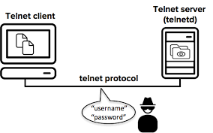
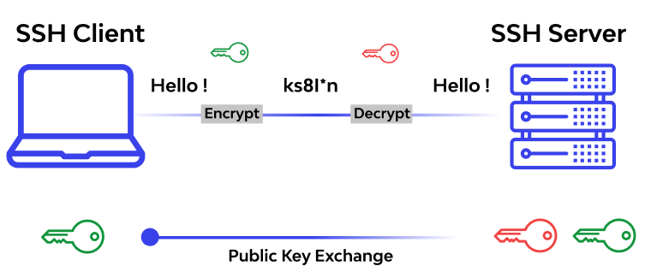
additional examples of Application layer protocols:
Telnet: Used to remotely control a computer terminal.
SSH (Secure Shell): Used to provide secure remote access to a computer.

Slide 11
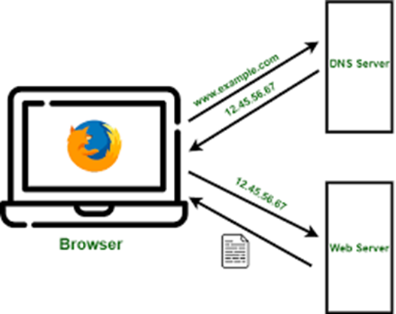

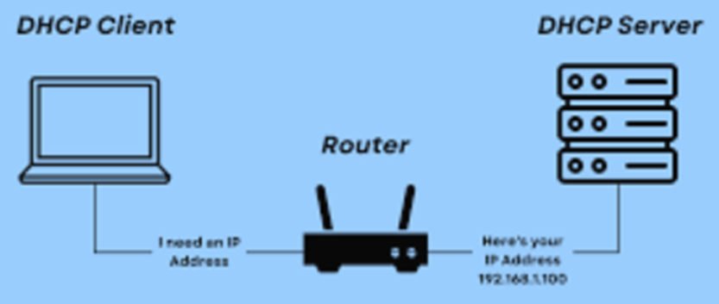
additional examples of Application layer protocols:
DNS (Domain Name System): Used to translate domain names, such as https://www.google.com/, into IP addresses.
DHCP (Dynamic Host Configuration Protocol): Used to automatically assign IP addresses and other network configuration settings to devices.

Slide 12
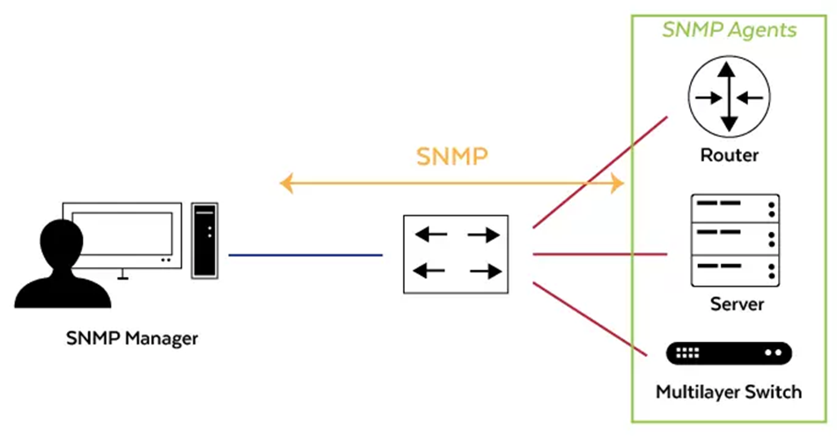
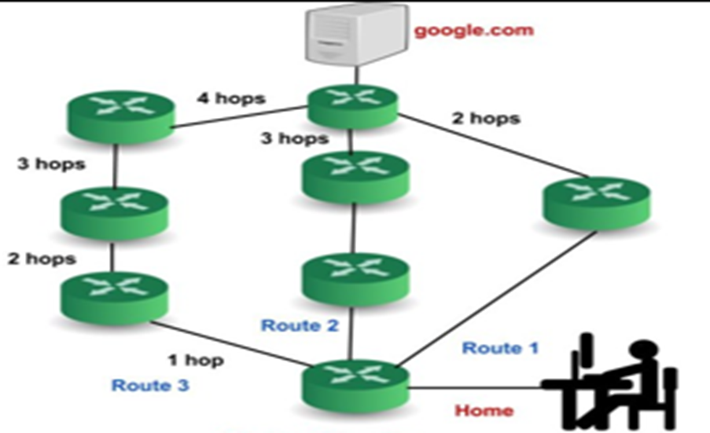

additional examples of Application layer protocols:
SNMP (Simple Network Management Protocol): Used to monitor and manage network devices.
RIP (Routing Information Protocol): Used by routers to exchange information about their networks.

Slide 13

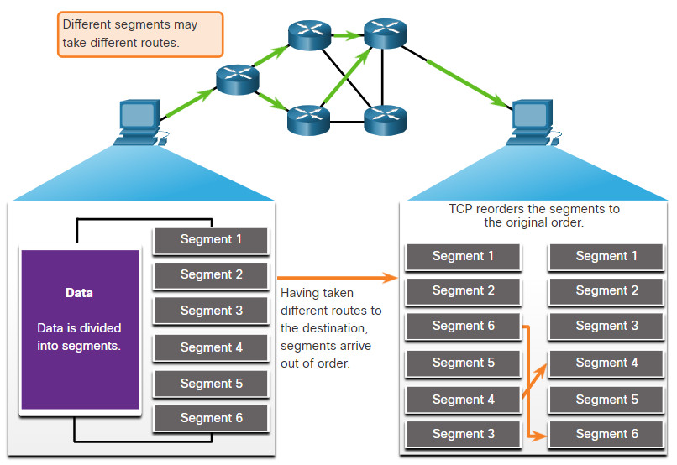
Transport layer
Transport layer:
Responsible for providing reliable end-to-end communication between applications.
Guarantees that no data is lost and that all segmented data—data that is a broken portion of a packet—is sent to the target application in the right sequence.
The two main Transport layer protocols are TCP and UDP.

Slide 14
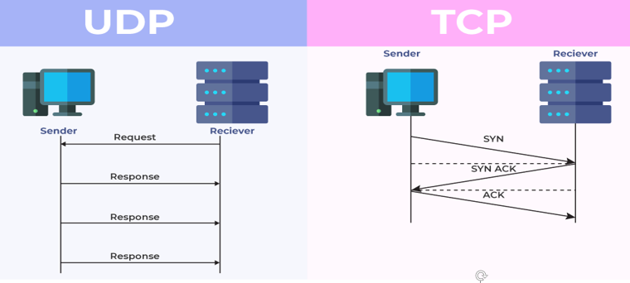
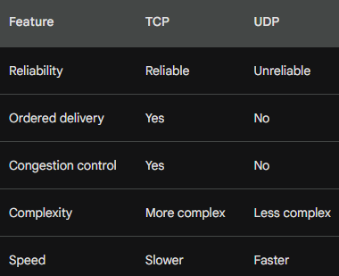
TCP and UDP in transport layer
TCP is a connection-based protocol and UDP is connectionless.
TCP is more reliable, it transfers data more slowly. UDP is less reliable but works more quickly.
TCP provides reliable, ordered delivery of data, while UDP provides unreliable, unordered delivery of data.
TCP uses a variety of mechanisms to ensure reliability, such as sequence numbers, acknowledgments, and retransmissions.
UDP is simpler and faster than TCP, but it does not provide reliability. UDP is often used for applications where speed is more important than reliability, such as real-time audio and video streaming.

Slide 15
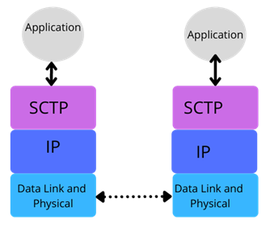

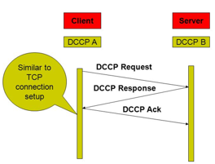
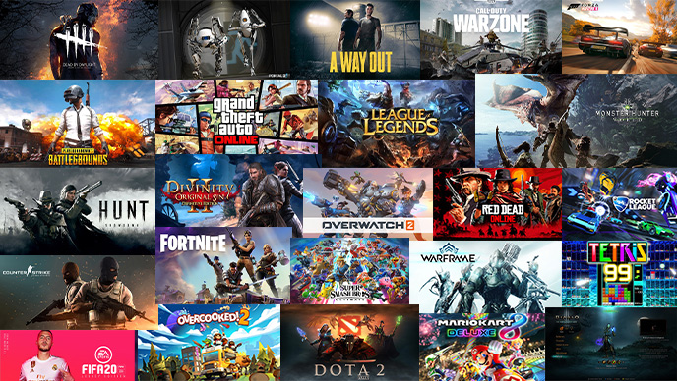
additional examples of Transport layer protocolS:
SCTP (Stream Control Transmission Protocol): Provides a reliable, ordered transport service for multiple streams of data. SCTP is often used for VoIP and video conferencing applications.
DCCP (Datagram Congestion Control Protocol): Provides congestion control for UDP traffic. DCCP is often used for online gaming and other applications where it is important to minimize latency.

Slide 16

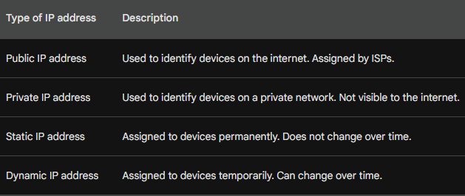
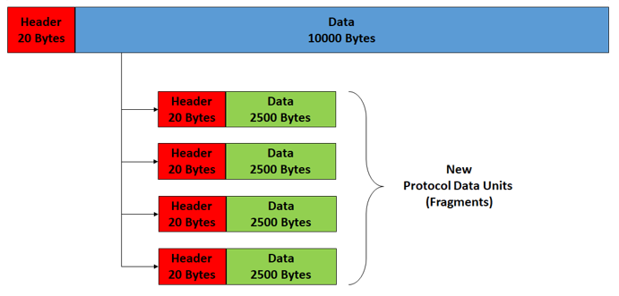
Internet layer
Internet layer:
The main protocol used at the internet layer is IP (Internet Protocol).
IP is responsible for assigning IP addresses to devices and routing packets between devices based on their IP addresses.
It also provides other services, such as fragmentation and reassembly, error detection and correction, and congestion control.

Slide 17
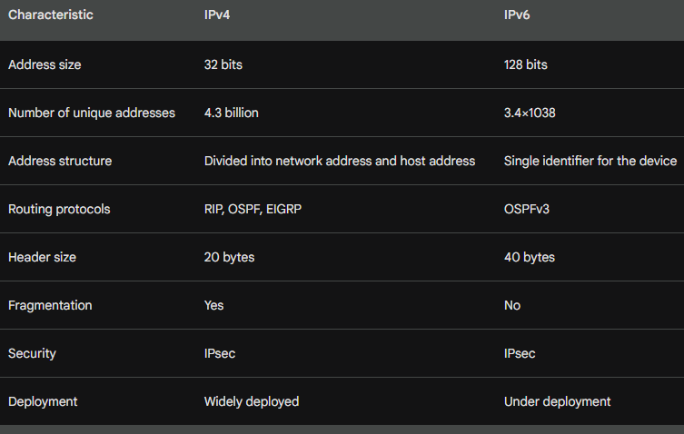
Internet layer
IPv4
IPv4 (Internet Protocol version 4) is the most widely used internet protocol today. It uses a 32-bit address space, which means that there are approximately 4.3 billion unique IPv4 addresses available.
IPv6
IPv6 (Internet Protocol version 6) is the next generation internet protocol. It uses a 128-bit address space, which means that there are approximately 3.4×1038 unique IPv6 addresses available.

Slide 18
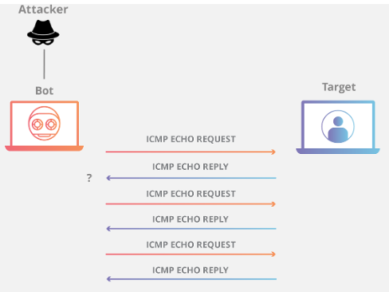
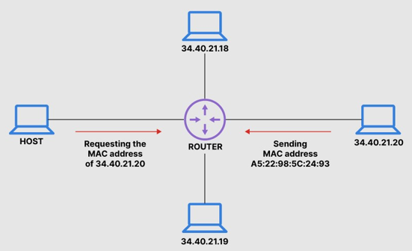
additional examples of INTERNET layer protocolS:
ICMP (Internet Control Message Protocol): Used to send and receive error messages and other control messages.
ARP (Address Resolution Protocol): Used to map IP addresses to MAC addresses.

Slide 19
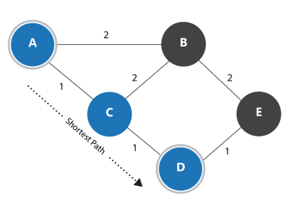
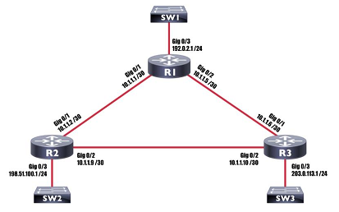
additional examples of INTERNET layer protocolS:
OSPF (Open Shortest Path First): Used by routers to find the shortest path between two networks.
EIGRP (Enhanced Interior Gateway Routing Protocol): Used a variety of metrics to calculate the best route to a destination, including bandwidth, delay, and load.

Slide 20

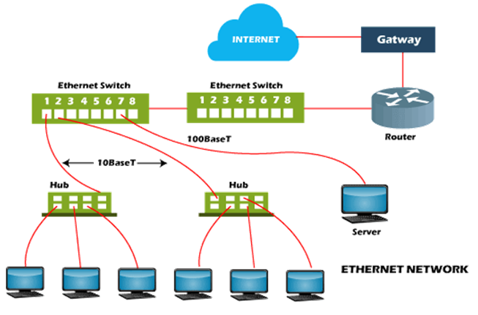
Link layer
Link Layer:
Responsible for transmitting packets of data over a physical network medium, such as Ethernet or Wi-Fi.
For example, Ethernet is commonly used on wired networks, while Wi-Fi is commonly used on wireless networks.

Slide 21


Types of Ethernet in link layer
Twisted pair Ethernet: Twisted pair Ethernet is the most common type of Ethernet. Twisted pair Ethernet can be divided into two categories:
Unshielded twisted pair (UTP): UTP is the most common type of twisted pair Ethernet. It is relatively inexpensive and easy to install. However, it is more susceptible to interference than shielded twisted pair (STP).
Shielded twisted pair (STP): STP is more expensive than UTP, but it is also more resistant to interference. STP is often used in environments where there is a lot of electrical noise, such as factories and offices.

Slide 22
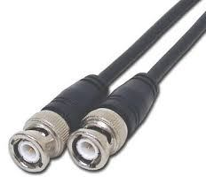
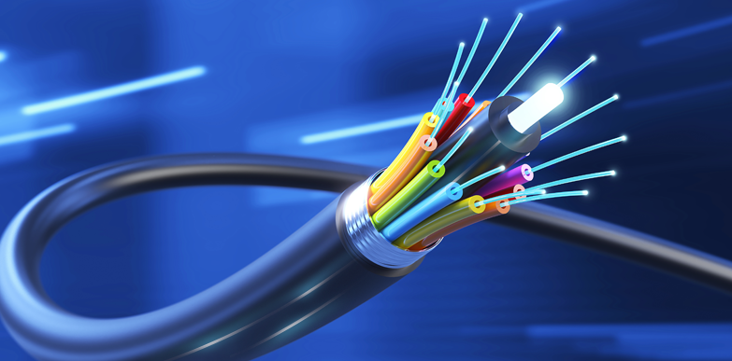
Types of Ethernet in link layer
Coaxial Ethernet: Coaxial Ethernet uses a single copper wire that is surrounded by an insulating layer and a braided metal shield. Coaxial Ethernet is less common than twisted pair Ethernet, but it can support higher data rates. Coaxial Ethernet is often used in cable TV networks.
Fiber optic Ethernet: Fiber optic Ethernet uses optical fibers to transmit data. Fiber optic Ethernet is the fastest type of Ethernet, but it is also the most expensive. Fiber optic Ethernet is often used in backbone networks and in data centers.

Slide 23
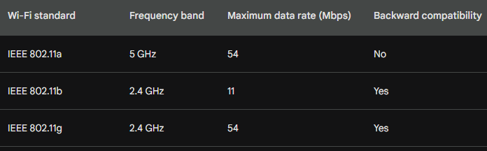
Types of wi-fi in link layer
IEEE 802.11a: Operates in the 5 GHz band and can support data rates up to 54 Mbps. It is less susceptible to interference than other Wi-Fi standards, but it has a shorter range.
IEEE 802.11b: Operates in the 2.4 GHz band and can support data rates up to 11 Mbps. It is the most common Wi-Fi standard, but it is more susceptible to interference than other Wi-Fi standards.
IEEE 802.11g: Operates in the 2.4 GHz band and can support data rates up to 54 Mbps. It is a backward-compatible version of IEEE 802.11b, which means that it can be used with older Wi-Fi devices.

Slide 24
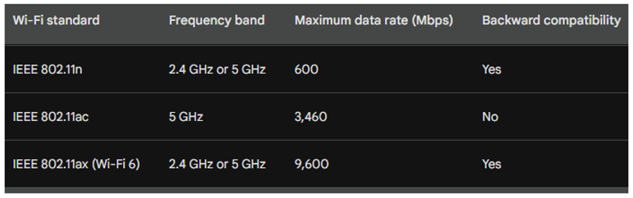
Types of wi-fi in link layer
IEEE 802.11n: Operates in the 2.4 GHz or 5 GHz band and can support data rates up to 600 Mbps. It is a significant improvement over previous Wi-Fi standards in terms of speed and range.
IEEE 802.11ac: Operates in the 5 GHz band and can support data rates up to 3.46 Gbps. It is the fastest Wi-Fi standard currently available.
IEEE 802.11ax (Wi-Fi 6): Operates in the 2.4 GHz or 5 GHz band and can support data rates up to 9.6 Gbps. It is a significant improvement over IEEE 802.11ac in terms of speed, efficiency, and reliability.

Slide 25
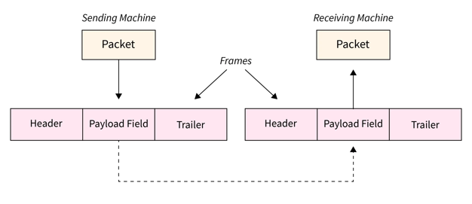
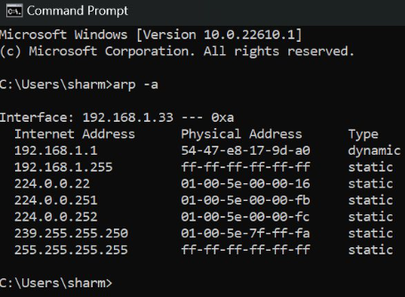
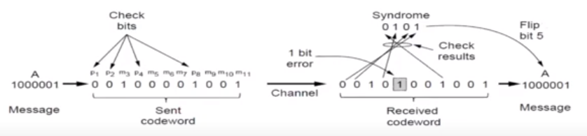
Link layer
The Link layer also performs other functions, such as:
Framing: The Link layer breaks data into units called frames. Frames are made up of a header, which contains information about the frame, and a payload, which contains the actual data.
Media access control (MAC): The Link layer controls access to the physical network medium. This is important because multiple devices may be trying to use the same medium at the same time.
Error detection and correction: The Link layer detects and corrects errors that occur during transmission. This is important because errors can corrupt data and make it unusable.

Slide 26
Importance of knowing the TCP/IP model
Advantages of knowing all the information of TCP/IP model:
Troubleshooting network problems: If you understand how the TCP/IP model works, you will be better equipped to troubleshoot network problems. For example, if you are having trouble connecting to a website, you can use your understanding of the TCP/IP model to identify where the problem is occurring.
Improving network performance: If you know how the TCP/IP model works, you can make changes to your network to improve its performance. For example, you can configure your router to use a different routing protocol or to prioritize certain types of traffic.
Designing and implementing networks: If you are designing or implementing a network, it is important to understand how the TCP/IP model works. This will help you to choose the right hardware and software for your network and to configure it correctly.
Improving security: If you know how the TCP/IP model works, you can take steps to improve the security of your network. For example, you can implement firewalls and other security measures to protect your network from attack.

Slide 27
Thank you!!!

